Slide 1
Frontend Technologies

Slide 2
Web Development
Entering in Web World

Slide 3
TRAINING AGENDA
A High-Level Overview of Web Development
Introduction to HTML, CSS & JavaScript
HTML Elements – Block and Text
Overview of Web Design and Website Personalities
Responsive Design Principles
HTML APIs –Storage, Socket, Canvas, Drag/Drop, Audio/Video etc

Slide 4
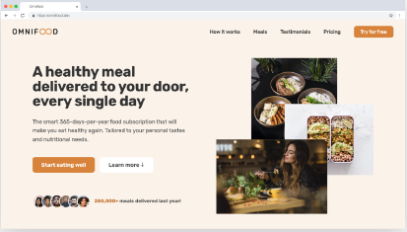
FRONTEND VS BACKEND DEVELOPMENT
index.html
styles.css
script.js
Images / links

Slide 5



FRONTEND VS BACKEND DEVELOPMENT
Request
Browser
Web
Server
Response
FRONT-END
DEVELOPMENT
The 3 Languages that BROWSER understands

Slide 6



FRONTEND VS BACKEND DEVELOPMENT
Browser
Request
Web
Server
App
DB
Response
BACKEND
DEVELOPMENT
Backend languages run on Server

Slide 7
THE 3 LANGUAGES OF FRONT-END
ADJECTIVES
p { color : ‘red’ }
means the paragraph text is red
NOUNS
<p></p>
means “paragraph”
VERBS
p.hide()
means hide the paragraph
FRONTEND DEVELOPMENT

Slide 8
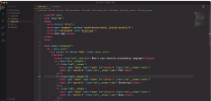

INTRODUCTION TO HTML
HyperText Markup Language
HTML is a markup language that web developers use to structure and describe the content of a webpage (not a programming language)
HTML consists of elements that describe different types of content: paragraphs, links, headings, images, video, etc.
Web browsers understand HTML and render HTML code as websites

Slide 9
PROTOCOLS
A protocol is a set of rules that define how communication occurs in a network
Internet Protocol (IP)
Ensures the successful delivery of packets from source to destination
Transmission Control Protocol (TCP)
TCP is a connection-oriented reliable protocol. Provides reliable transmission of packets.
User Datagram Protocol (UDP)
UDP is a connectionless and unreliable protocol
Hypertext Transfer Protocol (HTTP)
Helping applications to communicate with the users
File Transfer Protocol (FTP)
A standard network protocol provided by TCP/IP, and it is used to transfer files from one server to another
Secure Shell (SSH)
Network protocol that uses cryptography in order to secure network services over unsecured networks

Slide 10
Hypertext Transfer Protocol (HTTP)
The Hypertext Transfer Protocol (HTTP) is the foundation of the World Wide Web (WWW) and is used to load web pages using hypertext links
It allows the user to see a user-friendly interface designed to transfer information between networked devices
HTTP is a connectionless and stateless protocol. A client and server know each other only during communication
HTTP is also media independent. Any data can be sent through HTTP.

Slide 11

ANATOMY OF AN HTML ELEMENT
Element
Opening Tag
Content
Closing Tag
Name
of the element,
wrapped in angle brackets < and >
Content of the element, in
this example text. But it might be
another element (child element). Some
elements have no content (e.g. <img>)
Same as
opening tag, but with
a /. When element has
no content, it’s omitted

Slide 12
HTML Elements
title
specifies the label that appears in the browser window’s title bar.
meta
Provide information about the web page.
style
Writing internal stylesheet for your page.
script
Adding actions to your app by including JavaScript.
body
Includes various other elements to display data on webpage

Slide 13
Elements To Watch For…
blockquote
ul
p
ins/del
div
li
header
nav
footer
b
sup/sub
aside
abbr
pre
br
u
time
mark
span

Slide 14
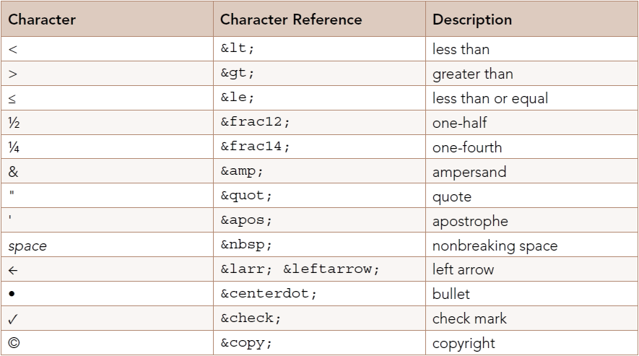
CHARACTER REFERENCES
Display a character that would otherwise be difficult to display.

Slide 15
THE TRIBUTE PAGE
You must include the following parts in your completed project:
You must include a title or heading on the tribute page.
You should include an image on the tribute page.
You included image must have a caption.
You should include a timeline of the life of the tribute in the form of a list

Slide 16
The Input (Form Input) Element
Accepting The User Inputs

Slide 17
<input> Elements
The <input> HTML element is used to create interactive controls for web-based forms in order to accept data from the user
Type | Description
button | A push button with no default behavior displaying the value of the value attribute, empty by default
checkbox | A check box allowing single values to be selected/deselected
color | A control for specifying a color; opening a color picker when active in supporting browsers
date | A control for entering a date (year, month, and day, with no time)
email | A field for editing an email address
file | A control that lets the user select a file
number | A control for entering a number
password | A single-line text field whose value is obscured

Slide 18
More On <input> Elements
Type | Description
radio | A radio button, allowing a single value to be selected out of multiple choices with the same name value
range | A control for entering a number whose exact value is not important
search | A single-line text field for entering search strings
submit | A button that submits the form
tel | A control for entering a telephone number
text | The default value. A single-line text field
time | A control for entering a time value with no time zone
url | A field for entering a URL

Slide 19
CSS
Let’s make it better looking

Slide 20
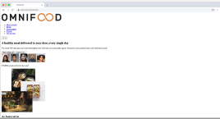
INTRODUCTION TO CSS
Cascading Style Sheets
CSS describes the visual style and presentation of the content written in HTML
CSS consists of countless properties that developers use to format the content: properties about font, text, spacing, layout, etc.
Web browsers understand HTML and render HTML code as websites

Slide 21
HOW WE SELECT AND STYLE ELEMENTS
A CSS RULE
{
color: blue;
font-size: 20px;
}
div
Selector
text-align: center;
Declaration / Style
Property
Value

Slide 22
CSS SELECTORS
Selector Type
Syntax
Description
Example
Universal
*
Selects all elements
* will match all the elements
Type
elementName
Selects all elements that have the given node name
input will match any <input> element.
Class
.classname
Selects all elements that have the given class attribute
.index will match any element that has a class of "index"
ID
#id
Selects an element based on the value of its id attribute
#toc will match the element that has the ID "toc"
Attribute
[attr]
Selects all elements that have the given attribute
[autoplay] will match all elements that have the autoplay attribute

Slide 23
MORE CSS SELECTORS
Selector Type
Syntax
Description
Example
Grouping Selector List
,
The , selector is a grouping method that selects all the matching nodes
div, span will match both <span> and <div> elements
Descendant combinator
“ “
The " " (space) combinator selects nodes that are descendants of the first element
div span will match all <span> elements that are inside a <div> element
Child combinator
>
The > combinator selects nodes that are direct children of the first element
ul > li will match all <li> elements that are nested directly inside a <ul> element.
General sibling combinator
~
The ~ combinator selects siblings. This means that the second element follows the first (though not necessarily immediately), and both share the same parent
p ~ span will match all <span> elements that follow a <p>, immediately or not.
Adjacent sibling combinator
+
The + combinator matches the second element only if it immediately follows the first element
h2 + p will match all <p> elements that immediately follow an <h2> element

Slide 24
MORE CSS SELECTORS
Selector Type
Syntax
Description
Example
Pseudo classes
:
The : pseudo allow the selection of elements based on state information that is not contained in the document tree
a:visited will match all <a> elements that have been visited by the user
Pseudo elements
::
The :: pseudo represent entities that are not included in HTML
p::first-line will match the first line of all <p> elements

Slide 25
Task
THE GOOD VIBES FORM
Forms are always an essential part of any project and you will be working with a lot of forms in most of the applications so why not practice it earlier and test your knowledge. Once you get familiar with the input field or basic tags in HTML to create a form make a project using all those tags. How to use a text field, checkbox, radio button, date, and other important elements in a single form. You will be learning how to give a proper structure to a webpage while creating a form. Knowledge of HTML/HTML5 is good enough but you can use a bit of CSS to make this project look better

Slide 26
HTML5 APIs’
Entering In The World Of Web Programming

Slide 27
AGENDA
Web Storage
Canvas
Audio / Video
Server-Sent Events
History Management
Drag & Drop
WebSocket

Slide 28
WEB STORAGE
The Web Storage API provides mechanisms by which browsers can store key/value pairs, in a much more intuitive fashion
Web Storage Type
sessionStorage maintains a separate storage area for each given origin that's available for the duration of the page session (as long as the browser is open, including page reloads and restores)
localStorage does the same thing, but persists even when the browser is closed and reopened.

Slide 29
sessionStorage vs. localStorage
sessionStorage
localStorage
Stores data only for a session, meaning that the data is stored until the browser (or tab) is closed.
Data is never transferred to the server.
Storage limit is larger than a cookie (at most 5MB).
Stores data with no expiration date, and gets cleared only through JavaScript, or clearing the Browser cache / Locally Stored Data.
Storage limit is the maximum amongst the two.

Slide 30
AUDIO / VIDEO API
HTML5 comes with elements for embedding rich media in documents — <video> and <audio> — which in turn come with their own APIs for controlling playback, seeking, etc.
HTMLMediaElement API provides features to allow you to control video and audio players programmatically

Slide 31
AUDIO / VIDEO API ATTRIBUTES
Attribute | Description
autoplay | Can tell the browser to play the video or audio automatically
controls | You can use some simple JavaScript to write your own controls or you can tell the browser to provide them automatically
poster (Video only) | The poster attribute points to an image that the browser will use while the video is downloading, or until the user tells the video to play
height, width | tell the browser the size in pixels of the video/audio
loop | loops the media playback
preloaded | it begins buffering when the page loads in the expectation that the user will activate the controls.
src | this attribute points to the file to be displayed

Slide 32
WORKING WITH CANVAS
The Canvas API provides a means for drawing graphics via JavaScript and the HTML <canvas> element.
Canvas can be used for animation, game graphics, data visualization, photo manipulation, and real-time video processing.
<canvas id="canvas"></canvas>
The HTMLCanvasElement.getContext() method gets that element's context—the thing onto which the drawing will be rendered.

Slide 33
DRAG & DROP
HTML Drag and Drop interfaces enable applications to use drag-and-drop features in browsers.
The user may select draggable elements with a mouse, drag those elements to a droppable element, and drop them by releasing the mouse button
You can customize which elements can become draggable, the type of feedback the draggable elements produce, and the droppable elements.
HTML drag-and-drop uses the DOM event model and drag events inherited from mouse events

Slide 34
DRAG & DROP EVENTS
Event | Event Handler | Fires when…
drag | ondrag | a dragged item (element or text selection) is dragged.
dragend | ondragend | a drag operation ends (such as releasing a mouse button or hitting the Esc key)
dragenter | ondragenter | a dragged item enters a valid drop target.
dragleave | ondragleave | a dragged item leaves a valid drop target
dragover | ondragover | a dragged item is being dragged over a valid drop target, every few hundred milliseconds
dragstart | ondragstart | the user starts dragging an item.
drop | ondrop | an item is dropped on a valid drop target.

Slide 35
HISTORY MANAGEMENT
The DOM Window object provides access to the browser's session history through the History object.
The Window History object methods and properties let you navigate back and forth through the user's history, and manipulate the contents of the history stack.
Moving backward and forward through the user's history is done using the back(), forward(), and go() methods.
The popstate event of the Window interface is fired when the active history entry changes while the user navigates the session history.

Slide 36
WEB SOCKETS
The WebSocket API makes it possible to open a two-way interactive communication session between the user's browser and a server.
With this API, you can send messages to a server and receive event-driven responses without having to poll the server for a reply.
Client
Server
Full Duplex Continuous Communication Channel

Slide 37
WEB SOCKETS
Interface | Description
WebSocket | The primary interface for connecting to a WebSocket server and then sending and receiving data on the connection.
CloseEvent | The event sent by the WebSocket object when the connection closes.
MessageEvent | The event sent by the WebSocket object when a message is received from the server.

Slide 38
SERVER SENT EVENTS
Traditionally, a web page has to send a request to the server to receive new data
With server-sent events, it's possible for a server to send new data to a web page at any time, by pushing messages to the web page.
Incoming messages can be treated as Events + data inside the web page.
Client
Server
One-way connection

Slide 39
REFERENCES
READING MATERIAL
VIDEO LINKS
https://developer.mozilla.org/en-US/docs/Web/HTML
https://html.com
https://developer.mozilla.org/en-US/docs/Learn/CSS/First_steps
https://www.youtube.com/playlist?list=PLWPirh4EWFpH2Pj1lQ4wMfPgdEjiDrTGA
https://www.youtube.com/playlist?list=PLu0W_9lII9agiCUZYRsvtGTXdxkzPyItg
https://www.youtube.com/watch?v=1Rs2ND1ryYc&t=2s

